Slide 1
Migrating Oracle to PostgreSQL
Notes:
Information in this document, including URL and other Internet Web site references, is subject to change without notice. Unless otherwise noted, the example companies, organizations, products, domain names, e-mail addresses, logos, people, places, and events depicted herein are fictitious, and no association with any real company, organization, product, domain name, e-mail address, logo, person, place or event is intended or should be inferred. Complying with all applicable copyright laws is the responsibility of the user. Without limiting the rights under copyright, no part of this document may be reproduced, stored in or introduced into a retrieval system, or transmitted in any form or by any means (electronic, mechanical, photocopying, recording, or otherwise), or for any purpose, without the express written permission of Microsoft Corporation.
Microsoft may have patents, patent applications, trademarks, copyrights, or other intellectual property rights covering subject matter in this document. Except as expressly provided in any written license agreement from Microsoft, the furnishing of this document does not give you any license to these patents, trademarks, copyrights, or other intellectual property.
The names of manufacturers, products, or URLs are provided for informational purposes only and Microsoft makes no representations and warranties, either expressed, implied, or statutory, regarding these manufacturers or the use of the products with any Microsoft technologies. The inclusion of a manufacturer or product does not imply endorsement of Microsoft of the manufacturer or product. Links may be provided to third party sites. Such sites are not under the control of Microsoft and Microsoft is not responsible for the contents of any linked site or any link contained in a linked site, or any changes or updates to such sites. Microsoft is not responsible for webcasting or any other form of transmission received from any linked site. Microsoft is providing these links to you only as a convenience, and the inclusion of any link does not imply endorsement of Microsoft of the site or the products contained therein.
© 2020 Microsoft Corporation. All rights reserved. Microsoft and the trademarks listed at https://www.microsoft.com/en-us/legal/intellectualproperty/Trademarks/Usage/General.aspx are trademarks of the Microsoft group of companies. All other trademarks are property of their respective owners.

Slide 2
Abstract and learning objectives
Abstract
In this whiteboard design session, you work with a group to design a proof of concept (POC) for conducting a site analysis for a customer to compare cost, performance, and level of effort required to migrate from Oracle to Azure Database for PostgreSQL. You evaluate the dependent applications and reports that need to be updated and come up with a migration plan. Also, you review ways to help the customer take advantage of new PostgreSQL features to improve performance and resiliency and consider the impact of migrating from on-premises to the cloud.
At the end of this whiteboard design session, you will be better able to design a database migration plan and implementation.
Notes:
This is an introduction to the Cloud Workshop at a high level. Later we’ll get into customer objections, requirements, etc., but we want to ground the participants on the business outcomes we’re going after for the day.

Slide 3
Step 1: Review the customer case study
Outcome
Analyze your customer needs.
Timeframe
15 minutes

Slide 4
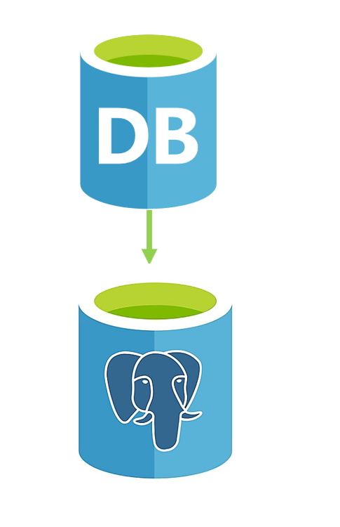
Customer situation
Wide World Importers experience huge growth
Tremendous influx of new data
Outage caused by audit table space shortfall
Requested POC to replace Oracle with Azure Database for PostgreSQL
Notes:
Wide World Importers (WWI) has had huge growth over the last few years
Resulted in a tremendous influx in new data they need to maintain their business
This data has become increasingly expensive to store in an Oracle Relational Database Management System (RDBMS)
Investigating replacing Oracle with Azure Database for PostgreSQL
Oracle has been slowing down as their growth has doubled
Oracle upgrades are long and expensive projects
Business stake holders have tired of the process and have requested a proof of concept on replacing Oracle with Azure Database for PostgreSQL
Investigating ways they can increase speed on their transactional databases without expensive new license fees
Realize an investment in new hardware is required, and are looking at this as more of a migration to a new system
They had a significant outage last year because one of their audit tables ran out of space. They’d like a full briefing on how to monitor that situation, so it doesn’t happen again, possible remedies would like high availability to be built into the project

Slide 5

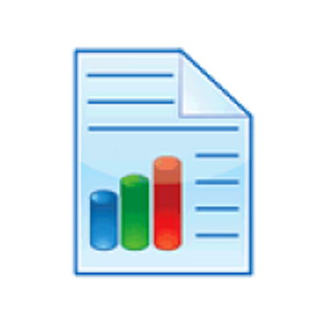

Customer Situation
Apps
Reports
Web/REST
Services
Notes:
WWI has several external and internal applications that need migrate with the database
The database is used by an online store application, written in ASP.NET MVC
Also have internal applications that manage their product catalog, written in Oracle Forms
They have many reports to aid in forecasting, sales reporting, and inventory maintenance
Reports are a mixture of Power BI, Excel, and Oracle Forms
Hit the Oracle OLTP database directly
Web / Representational State Transfer (REST) services
WWI also uses this database to interact with vendors, exposing to vendors via a REST service
Maintained by WWI
Existing web service that interacts with a vendor to get the latest certifications of that vendors’ products
The JavaScript Object Notation (JSON) parser sometimes fails and they can’t figure out why
Want to store the original, unparsed JSON in a table for troubleshooting purposes
Want to query the JSON data by date or by other identifying pieces of the JSON that might be available for troubleshooting

Slide 6

Customer needs
Migrate from Oracle to PostgreSQL
Understand PostgreSQL migration impact on existing apps and services
Notes:
Migrate an existing Oracle database to PostgreSQL on-premises, PostgreSQL in an Azure VM, or Azure Database for PostgreSQL
Impact on apps and services
Needs to understand what is involved in migrating the external sales application to PostgreSQL
Wants better understanding of what to do with the internal Oracle Forms application
Has multiple touch points with external vendors and needs to know what needs to change with those web services

Slide 7
Customer needs
Web-based visualizations and reporting
Store raw JSON data
Wants to avoid outages caused by disk space
Does PostgreSQL have an answer to Oracle RAC
Notes:
Need web-based visualizations on sales and forecasting
Needs a plan on how to upgrade their existing reporting infrastructure
Has a new requirement on what to do with JSON data
Had an outage last year and is hyper concerned with not repeating that experience
Their audit table filled up and they ran out of disk space
Want to know what would have happened if PostgreSQL experienced the same issue, and what you’re your solution would be
As a follow up, they’d also like to know how to answer the Oracle DBA’s allegation that PostgreSQL doesn’t have an answer for Oracle Real Application Clusters (RAC)

Slide 8



Customer objections
Does upgrade need to be on-premises first?
Can we see POCs for both on-premises and PostgreSQL migrations?
Do apps need to be rewritten?
Do reports need to be rewritten?
Will security migrate over?
Notes:
1. Do we need to upgrade to on-premises PostgreSQL first or go can we go straight to Azure?
2. Can we have two proofs-of-concept that demonstrate both migrations?
3. Do we need to rewrite all our applications for Azure Database for PostgreSQL?
4. Do we need to rewrite all our reports for Azure Database for PostgreSQL?
5. Will our security migrate over from Oracle to Azure Database for PostgreSQL? How do we handle security in the new database?

Slide 9

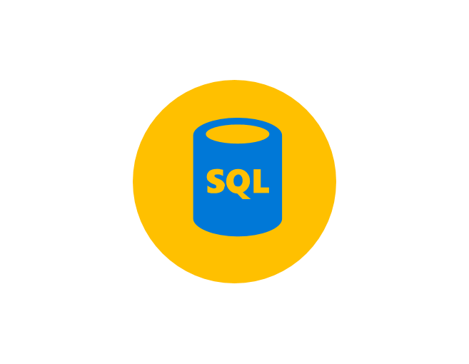
Customer objections
How do we store JSON data?
Will PostgreSQL crash if audit logs fill up?
How can we control costs using PostgreSQL?
Are there any features of Oracle that PostgreSQL does not have?
Notes:
6. Do we need to invest in a JSON storage system for the JSON data we're storing from our vendor's web service?
7. What will we do if our audit logs fill up again? Will Azure Database for PostgreSQL crash the same way Oracle did?
8. If we take advantage of new features, will our license costs keep ratcheting up and up? Will we have a dependable way of budgeting for this project?
9. Are there any Oracle features required by WWI for which Azure Database for PostgreSQL has no equivalent?

Slide 10

Customer objections
Do we need to inform vendors of database changes?
How will Power BI be migrated?
Notes:
10. Do we need to tell all our vendors that we're changing databases, so their integrations work?
11. What will happen with Power BI?

Slide 11
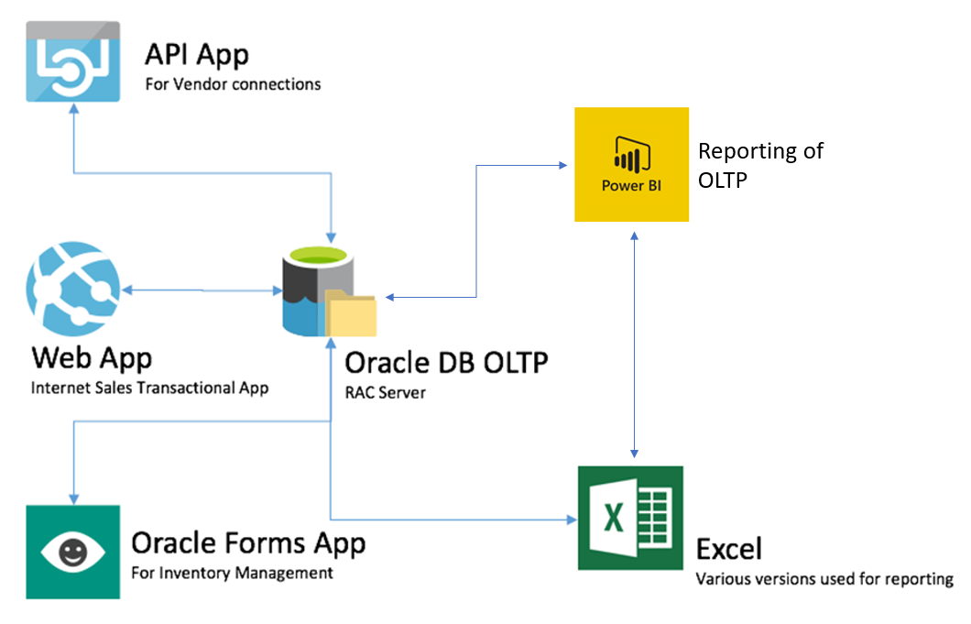
Common scenarios
Notes:
This is a diagram of a common architecture for this type of scenario, from which you can draw inspiration. You will find this diagram within the Whiteboard Design Session Student Guide.

Slide 12
Step 2: Design the solution
Outcome
Design a solution and prepare to present the solution to the target customer audience in a 15-minute chalk-talk format.
Timeframe
60 minutes
Business needs (10 minutes) | Respond to questions outlined in your guide and list the answers on a flipchart.
Design (35 minutes) | Design a solution for as many of the stated requirements as time allows. Show the solution on a flipchart.
Prepare (15 minutes) | Identify any customer needs that are not addressed with the proposed solution. Identify the benefits of your solution. Determine how you will respond to the customer’s objections. Prepare for a 15-minute presentation to the customer.

Slide 13
Step 3: Present the solution
Outcome
Present a solution to the target customer in a 15-minute chalk-talk format.
Timeframe
30 minutes (15 minutes for each team to present and receive feedback)
Directions
Pair with another table.
One table is the Microsoft team and the other table is the customer.
The Microsoft team presents their proposed solution to the customer.
The customer asks one of the objections from the list of objections in the case study.
The Microsoft team responds to the objection.
The customer team gives feedback to the Microsoft team.

Slide 14
Wrap-up
Outcome
Identify the preferred solution for the case study.
Identify solutions designed by other teams.
Timeframe
15 minutes

Slide 15

Preferred target audience
Kathleen Sloan, CIO of Wide World Importers
Primary audience is business and technology decision makers.
Usually talk to Infrastructure Managers who report to the CIO, or to application sponsors (like a VP LOB, CMO) or to those that represent the Business Unit IT or developers that report to application sponsors.
Notes:
Kathleen Sloan, CIO of Wide World Importers (WWI)
The primary audience is business decision makers and technology decision makers
Usually we talk to the Infrastructure Managers who report to the CIO, or to application sponsors (like a VP LOB, CMO) or to those that represent the Business Unit IT or developers that report to application sponsors.

Slide 16
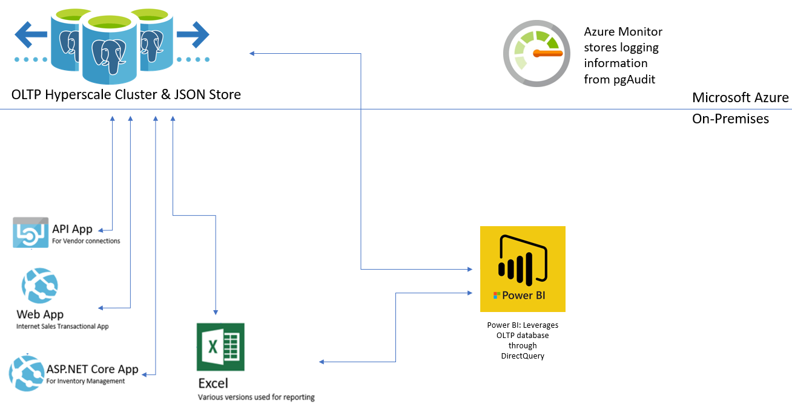
Preferred solution
Notes:
This preferred solution is just one of many viable options
From a high-level:
WWI decided that Azure Database for PostgreSQL would in fact be the right choice for their platform
Decided to load schema using ora2pg and data with Azure Database Migration Service
Migrate their Oracle Forms application to Microsoft ASP.NET Core
They are very concerned about how to do this and what method to use
They are leaning towards a total rewrite to ASP.NET Core. They would like the POC to include this.
The POC should demonstrate that Azure Database for PostgreSQL - Hyperscale (Citus) will give them the reliability and performance they expected Oracle to deliver for them
POC should include:
MVC app which changes the connectionString from Oracle to PostgreSQL in Entity Framework (EF)
A basic form which mirrors the Oracle Forms app
Current Oracle database migrated to Azure Database for PostgreSQL in a test environment
Creating Power BI reports from datasets that point to Azure Database for PostgreSQL
Testing repointing some of the Excel worksheets to a new OLTP database
Implement new features in the OLTP PostgreSQL database including:
JSON data store
Audit Logs sent to Azure Monitor
Hyperscale (Citus)

Slide 17
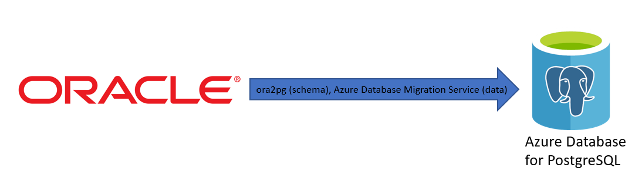
Preferred solution
Oracle schema and data movement
Notes:
How would you recommend that WWI move their data and schema into PostgreSQL? What services would you suggest and what are the specific steps they would need to take to prepare the data, to transfer the data, and where would the loaded data land?
ora2pg is an open-source tool that can convert most of the Oracle schema to a PostgreSQL-compatible one, assess the source database to identify the difficulty of the migration task, and copy data. Complex stored procedures and functions still require developer custom upgrades.
However, ora2pg struggles with online migrations (initial migration + incremental). Therefore, we are using Azure Database Migration Service (DMS) Premium tier to migrate data. Note that DMS can only migrate table schemas, not other objects
With DMS, you first create a new project. Then you connect to the Oracle source database. Then connect to the PostgreSQL destination database. If you choose to create the target tables before using DMS, you will map source tables to target tables. Otherwise, you will simply map the source and target databases.
Run the migration. Changes made to the source database during the migration will be applied automatically (incremental data sync)

Slide 18
Preferred solution
Application changes
Are they using an ORM for apps and services
Oracle Forms app needs to be rewritten
Store, manage, and query JSON with PostgreSQL
Notes:
What product would you recommend to WWI to migrate their storefront MVC application to the new PostgreSQL database?
A specific product might not be needed, but you might evaluate whether they are using an ORM or not. If they are using Entity Framework, Dapper, or nHibernate, then the application should migrate much more easily.
If they didn’t use an ORM, then much of the data-layer code will need to be rewritten
If this code is consolidated, and only plain old CLR objects (POCOs) are being handed back using the repository pattern, then we might be able to replace the entire tier with Entity Framework or another object-relational mapping (ORM) tool
If there has been bleeding between the layers, then this process might be significantly more difficult
The entire store front application would need to be refactored and tested eventually
For the POC, they are looking to switch the connection string, test several pages related to an order, and get a good idea on the work that would be necessary to get that to work.
How would you migrate the Oracle Forms applications? How would you define success? Are there any technologies the customer needs to know about?
The Oracle Forms application will need to be completely rewritten
There is guidance from Microsoft on how to do that to Visual Basic.NET
There are third party tools that will attempt to automatically rebuild an Oracle Forms application to Windows Presentation Foundation (WPF) and Model-View-ViewModel (MVVM)
You can also rewrite this by hand into any technology the client would like
Oracle Forms applications cannot be easily cloud hosted. This application would eventually need to be rewritten if they’d like new experiences like a mobile experience, a tablet application, or hosted in Microsoft Azure.
What will you do about the vendor touch points? How will you recommend they store the JSON data?
The REST services need to be approached the same way the MVC store front application is approached. If they’ve used an ORM, then we can just repoint the connectionStrings and redeploy.
JSON data can be stored in a JSONB field in PostgreSQL
They can be queried and indexed through powerful JSON operators
Preferable to the JSON type (though it has faster inserts)

Slide 19
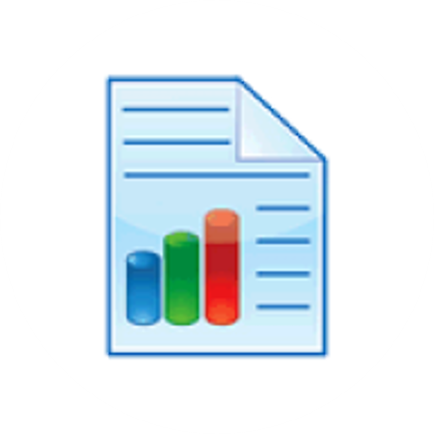
Preferred solution
Reporting
Reports
Identify
Upgrade
Notes:
How can they discover what reports and Excel spreadsheets that hit the Oracle database need to be upgraded? What’s a proper upgrade path?
There’s an Oracle Profiler API that can be used to store trace information into tables. These tables can be queried to see if we’ve identified all reports and artifacts that we need to upgrade.
We can put individual queries into stored procedures and upgrade them using ora2pg. We can also use ora2pg to upgrade individual queries to PL/pgSQL

Slide 20
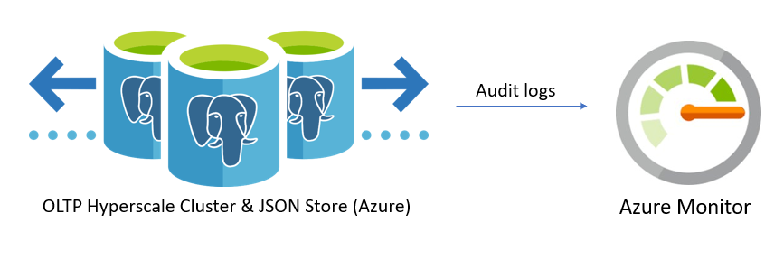
Preferred solution
High-availability and audit table
Notes:
If our solution was PostgreSQL, what could WWI have done with the audit table when it filled up?
PostgreSQL's logging tools and pgAudit export events in .log files
Azure Database for PostgreSQL can export these files as JSON for storage in Azure Monitor, where they can be analyzed, visualized, and used in more ways
Alternatively, if the limited log storage area of an Azure Database for PostgreSQL instance fills completely, the oldest log files will be deleted, even if their retention period hasn’t completed yet
What are the PostgreSQL options for high availability?
PostgreSQL provides several options for creating high availability for a server or database. High-availability options include the following:
Hyperscale (Citus) clusters two instances to serve as a single node with automatic failover (no data loss)
Hyperscale (Citus) shards databases, and each shard is stored in multiple locations throughout the cluster
Replication options
Log shipping

Slide 21

Preferred solution
Azure Database for PostgreSQL POC
On-premises upgrade acceptable option
Consider migration into Azure for long-term cost savings and simplifying future upgrades
Answer questions before beginning POC
Notes:
Should they move to on-premises first?
This is a perfectly acceptable option
If we do, we might consider using the high availability and performance features of a Hyperscale (Citus) cluster
Other on-premises applications might keep them on-premises until they can figure out how to move those applications to the cloud
It depends on the integration touchpoints, network latency needs, and reliable internet connectivity for all offices
Is there any benefit to going straight to Microsoft Azure? Does Azure Database for PostgreSQL take care of all their requirements?
If the organization has chosen to go to the cloud, this might be a long-term cost savings of skipping purchasing the on-premises hardware
If the applications are already cloud-based, or they have many external applications needing access, then this would not affect latency while removing the burden from WWI of maintaining the connectivity with all their integration partners
In addition, they would gain the benefit of simplifying future software upgrades so the current investment in new hardware was necessary. Some of their products would upgrade and offer new features with minimal effort on their part
Are there any questions we need answered before we can begin a POC directly to Microsoft Azure?
What is network connectivity like between on-premises and the cloud?
What are our long-term cloud plans? Is there a mandate to go there any way?
Where is the rest of the data integration points stored? Are they on-premises? Is anything in Microsoft Azure already?
Are there any cloud products that are already on the roadmap for the organization?

Slide 22
Preferred objections handling
Does upgrade need to be on-premises first?
Can we see POCs for both on-premises and PostgreSQL migrations?
Do apps need to be rewritten?
Do reports need to be rewritten?
Will security migrate over?
Notes:
Do we need to upgrade to on-premises PostgreSQL first or go straight to Azure?
This is joint business decision and technical decision. Azure Database for PostgreSQL (single server or Hyperscale) or PostgreSQL in a VM will offer all the features they’ve stated that they need. There’s a migration path to both.
If they have a long-term strategy to move to the cloud, have already moved some resources there, have a plan to co-locate with a partner data center, or have identified cloud services they’d like to take advantage of, then moving straight to the cloud might be preferred
It might be easier to be on-premises if they don’t have ExpressRoute for their Excel spreadsheets and other on-premises resources that can’t migrate to Azure quite yet
Can we have two proof of concepts that demonstrate both migrations?
Two proof of concepts are possible and easy to do.
The application architecture might be quite a bit different if we choose to use Platform as a Service (PaaS)
The online sales application and the web services would migrate to Azure Websites
The changes made to existing Excel and Power BI reports would be minor
Do we need to rewrite all our applications for Azure Database for PostgreSQL?
The Oracle Forms application would have to be rewritten to ASP.NET Core or ASP.NET MVC
Migration tools available to help from third-parties if they choose to migrate to ASP.NET MVC
The rewrite effort will need to be planned and implemented.
For the POC, show a basic CRUD (create, read, update, delete) data entry form to show how the project would be structured
Use Entity Framework if appropriate to make the CRUD migration easier
Use of Entity Framework, or another ORM, in the existing applications and services will make migration easier
It’s possible that we could repoint the connectionString, re-run the unit tests, and the application will just work
Blockers might be if Entity Framework is using Stored Procedures in Oracle. Those will need to be tested after we run ora2pg to migrate them
Do we need to rewrite all our reports for Azure Database for PostgreSQL?
Power BI reports should migrate over with just a change to the connectionString
Power Query code may need to be modified
If Excel reports use simple queries to views or stored procedures, then changing the connectionString might work with them, also. If not, then the queries that drive the spreadsheets will need to be rewritten
ora2pg can also convert specific, individual queries from PL/SQL to PL/pgSQL
Will our security migrate over from Oracle to PostgreSQL? How do we handle security in the new database?
ora2pg does have the ability to migrate privileges granted to users
Security concepts in Oracle differ from PostgreSQL. For instance, roles in PostgreSQL are not database-scoped (a user can manipulate data in any database on the system, if they have the permissions to do so)

Slide 23
Preferred objections handling
How do we store JSON data?
Will PostgreSQL crash if audit logs fill up?
How can we control costs using Azure Database for PostgreSQL?
Are there any features of Oracle that Azure Database for PostgreSQL does not have?
Notes:
Do we need to invest in a JSON storage system for the JSON data we’re storing from our vendor’s web service?
JSON data can be stored in PostgreSQL as a JSONB field
It can be queried and indexed using JSON operators
Power BI is compatible with JSON data, allowing the creation of reports to view bad data that didn’t parse
What will we do if our audit logs fill up again? Will PostgreSQL crash the same way Oracle did?
We can use Azure Monitor to store and analyze audit logs
Each Azure Database for PostgreSQL instance has its own limited log storage area, and logs will be deleted if they require too much space. So, it is not possible for audit logs to cause crashes
If we take advantage of new features, will our license costs keep ratcheting up and up? Will we have a dependable way of budgeting for this project?
You can easily add functionality to Azure Database for PostgreSQL by leveraging the wide range of available free extensions (Oracle databases require that users pay for new features)
Microsoft has transparent billing methods, with features such as reserved pricing, which reduces the hourly amount paid for compute resources
Are there any Oracle features required by WWI for which Azure Database for PostgreSQL has no equivalent?
Nothing in the customer requirements is exclusive to an Oracle ecosystem
Oracle Forms is unique to Oracle, but Microsoft offers several replacement technologies, including LightSwitch, SharePoint Forms, Power Apps, ASP.NET MVC, WPF Forms, and ASP.NET Core applications
The customer might implement Oracle RAC, but managed Azure Database for PostgreSQL - Hyperscale (Citus) is simpler to provision and manage, and offers excellent performance

Slide 24
Preferred objections handling
Do we need to inform vendors of database changes?
How will Power BI be migrated?
Notes:
Do we need to tell all of our vendors that we’re changing databases so their integrations work?
As long as we test and refactor the web services they use, they shouldn’t know that you switched your back-end data store
What will happen with Power BI?
Developers can connect to Azure Database for PostgreSQL from Power BI desktop through DirectQuery, but when reports are deployed to Power BI Service (for web-based reporting), data must be imported into the model

Slide 25
Customer quote
“We are excited that an Azure Database for PostgreSQL environment will help our organization grow and prosper for many years into the future.”
- Kathleen Sloan, CIO of Wide World Importers

